Slide 1
Joins in SQL

Slide 2
Joins
SQL Join is used to fetch data from two or more tables, which is joined to appear as single set of data.
It is used for combining column from two or more tables by using values common to both tables.

Slide 3
Types of SQL JOIN
EQUI JOIN
EQUI JOIN is a simple SQL join.
Uses the equal sign(=) as the comparison operator for the condition
NON EQUI JOIN
NON EQUI JOIN uses comparison operator other than the equal sign.
The operators uses like >, <, >=, <= with the condition.
Types of SQL EQUI JOIN
INNER JOIN
Returns only matched rows from the participating tables.
Match happened only at the key record of participating tables.
OUTER JOIN
Returns all rows from one table and
Matching rows from the secondary table and
Comparison columns should be equal in both the tables.
List of SQL JOINS
INNER JOIN
LEFT JOIN OR LEFT OUTER JOIN
RIGHT JOIN OR RIGHT OUTER JOIN
FULL OUTER JOIN
NATURAL JOIN
CROSS JOIN
SELF JOIN

Slide 4
Types of JOIN
Following are the types of JOIN that we can use in SQL:
Inner
Outer
Left
Right

Slide 5
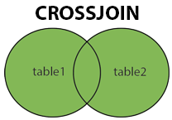
Cross JOIN or Cartesian Product
This type of JOIN returns the cartesian product of rows from the tables in Join. It will return a table which consists of records which combines each row from the first table with each row of the second table.
Cross JOIN Syntax is,
SELECT column-name-list FROM table-name1 CROSS JOIN table-name2;
SELECT * FROM class CROSS JOIN class_info;

Slide 6
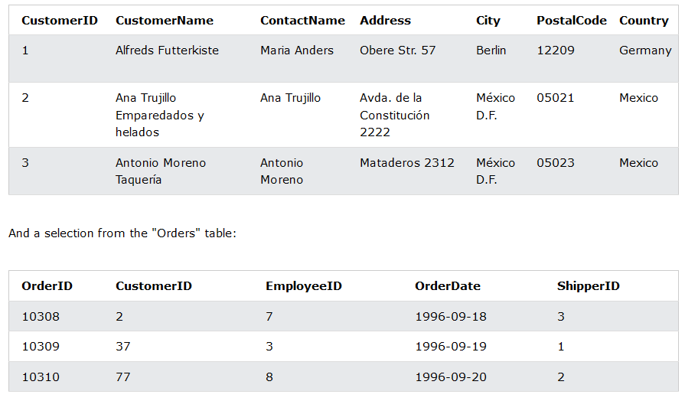
EXAMPLE
SELECT Customers.CustomerName, Orders.OrderID FROM Customers CROSS JOIN Orders;

Slide 7
INNER Join or EQUI Join
This is a simple JOIN in which the result is based on matched data as per the equality condition specified in the SQL query.
Inner Join Syntax is,
SELECT column-name-list FROM table-name1 INNER JOIN table-name2 WHERE table-name1.column-name = table-name2.column-name;
SELECT * from class INNER JOIN class_info where class.id = class_info.id;

Slide 8
EXAMPLE
SELECT Customers.CustomerName, Orders.OrderID FROM Customers CROSS JOIN Orders WHERE Customers.CustomerID=Orders.CustomerID;

Slide 9
Natural JOIN
Natural Join is a type of Inner join which is based on column having same name and same datatype present in both the tables to be joined.
The syntax for Natural Join is,
SELECT * FROM table-name1 NATURAL JOIN table-name2;
SELECT * from class NATURAL JOIN class_info;

Slide 10
OUTER JOIN
Outer Join is based on both matched and unmatched data. Outer Joins subdivide further into,
Left Outer Join
Right Outer Join
Full Outer Join

Slide 11
LEFT Outer Join
The left outer join returns a result set table with the matched data from the two tables and then the remaining rows of the left table and null from the right table's columns.
Syntax for Left Outer Join is,
SELECT column-name-list FROM table-name1 LEFT OUTER JOIN table-name2 ON table-name1.column-name = table-name2.column-name;

Slide 12
RIGHT Outer Join
The right outer join returns a result set table with the matched data from the two tables being joined, then the remaining rows of the right table and null for the remaining left table's columns.
Syntax for Right Outer Join is,
SELECT column-name-list FROM table-name1 RIGHT OUTER JOIN table-name2 ON table-name1.column-name = table-name2.column-name;

Slide 13
Full Outer Join
The full outer join returns a result set table with the matched data of two table then remaining rows of both left table and then the right table.
Syntax of Full Outer Join is,
SELECT column-name-list FROM table-name1 FULL OUTER JOIN table-name2 ON table-name1.column-name = table-name2.column-name;

Slide 14
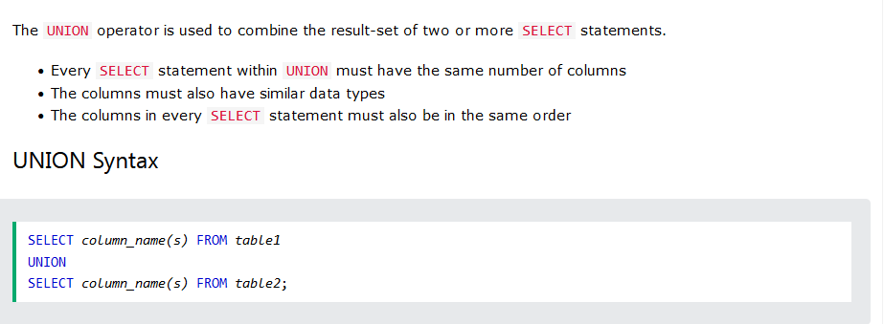
The MySQL UNION Operator

Slide 15
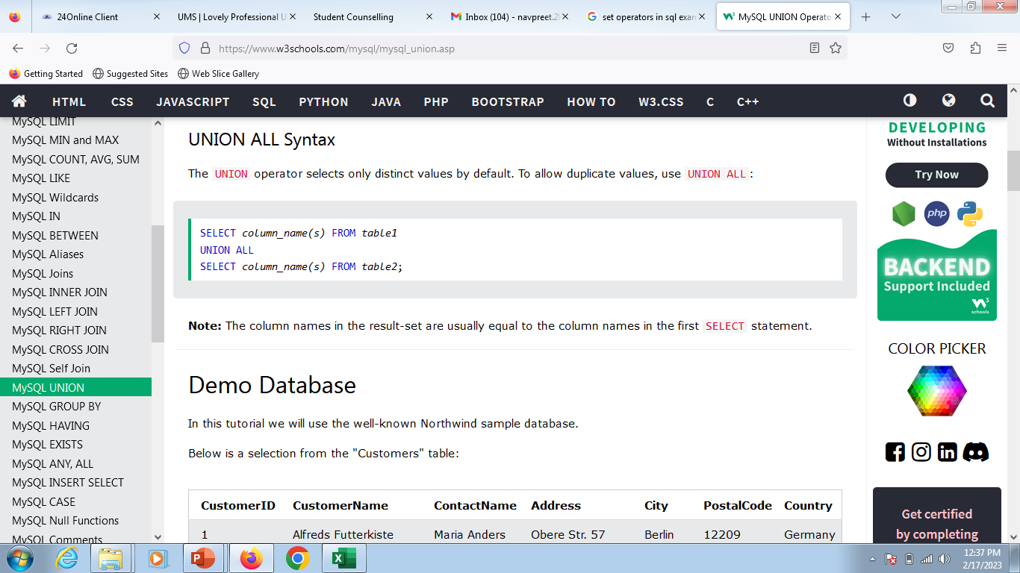
The MySQL UNION Operator

Slide 16
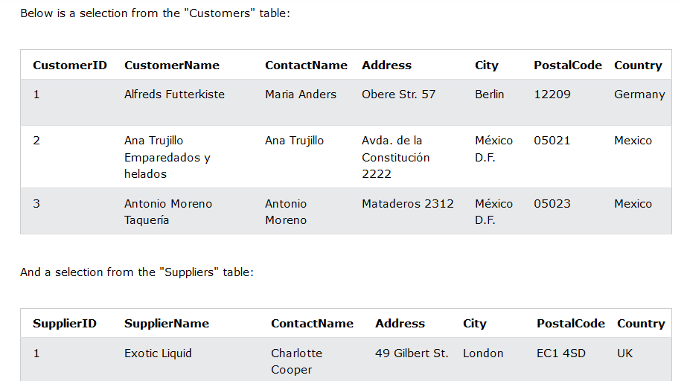
EXAMPLE

Slide 17
QUERY
SELECT City FROM Customers UNION SELECT City FROM Suppliers ORDER BY City;
SELECT City FROM Customers UNION ALL SELECT City FROM Suppliers ORDER BY City;
SELECT City, Country FROM Customers WHERE Country='Germany' UNION SELECT City, Country FROM Suppliers WHERE Country='Germany' ORDER BY City;

